Slide 1



DataViz: Visualizer and Parser for ACL Data
Angry Nerds
Manan Rathod
Kondury Rishabh
Pratyush Parashar
Problem Statement
To come up with unique, innovative visualization of these rules of engagement which is easy to understand and most importantly efficient in terms of loading on the screen.
Current Methods and Improvements
The current method involves the network administrator to use a large source and destination matrix for queries and has no visualization access. It also becomes unmanageable in terms of processing speed and storage.
We have tried to ease up the load by our platform DataViz!
Tech Stack
C++ Python Streamlit
Data Structures
Graphs and Hashmaps

Slide 2
Methodology
1
2
3
4
Input Generation
Generated the inputs using Python and C++ scripts.
Data Parsing
Efficient Data Structure
Visualization
Creating better representation of the information as charts and heatmaps.
Transformed the input into structured format.
Data is stored in the form of graphs and hashmaps to manage store and optimal querying
Input Data Characteristics
Access List - 500 rules and upto 20 statements
10,000 CTS role based Permissions

Slide 3
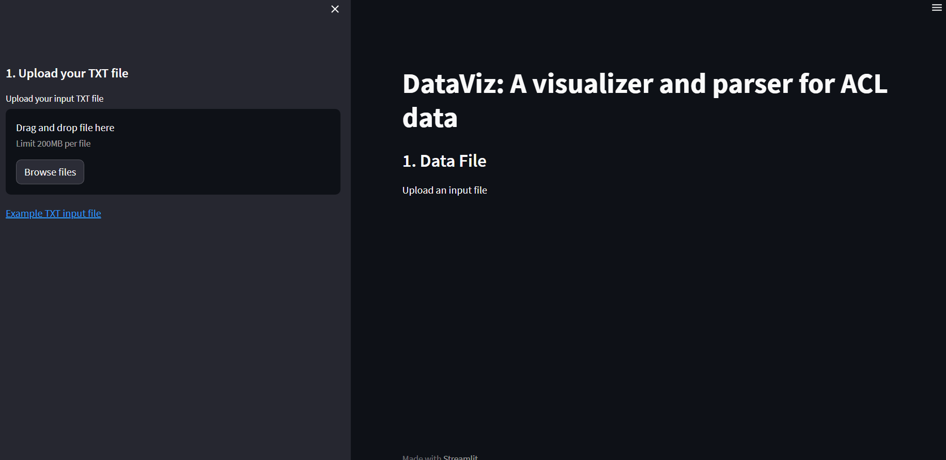
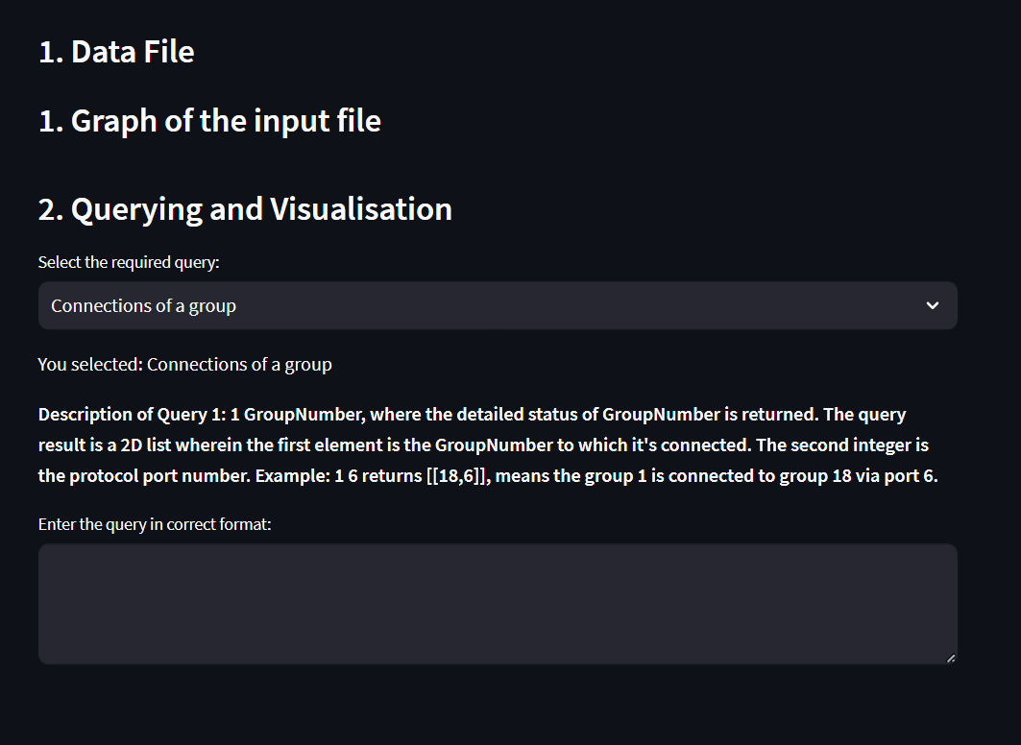
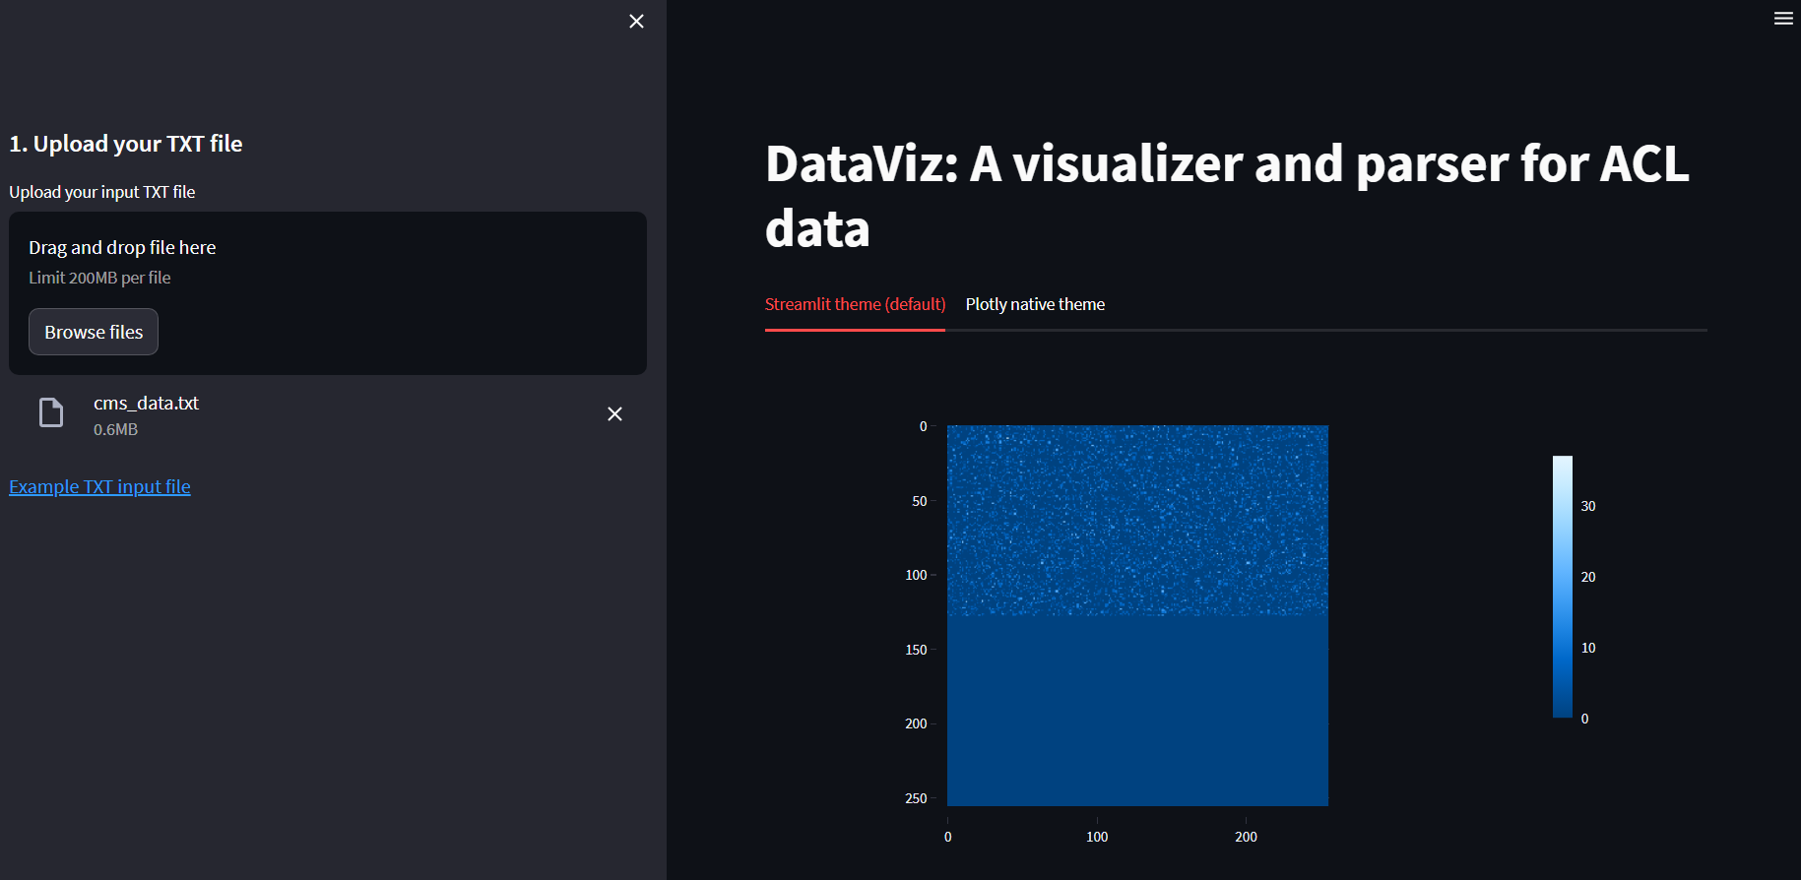
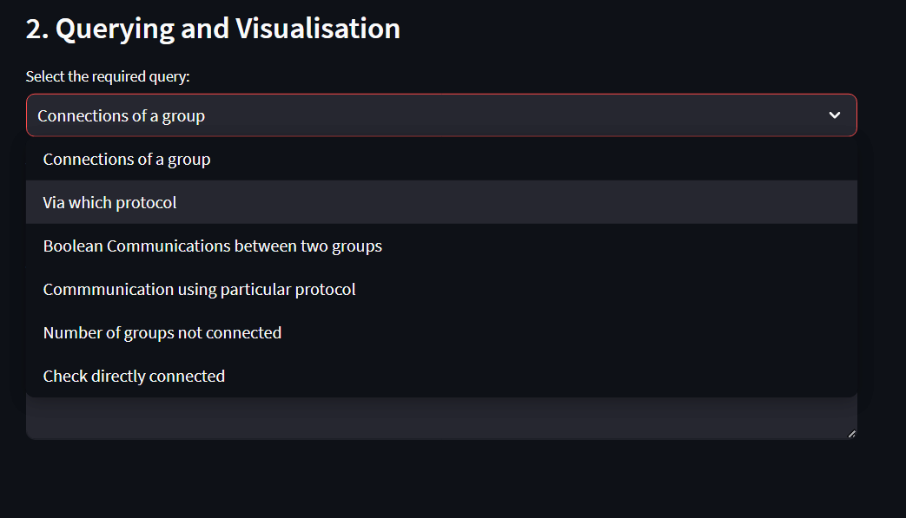
Home Page of DataViz
Queries along with Descriptions
Heatmap Visualization of ACL Data
Types of Queries regarding ACL Data

Slide 4
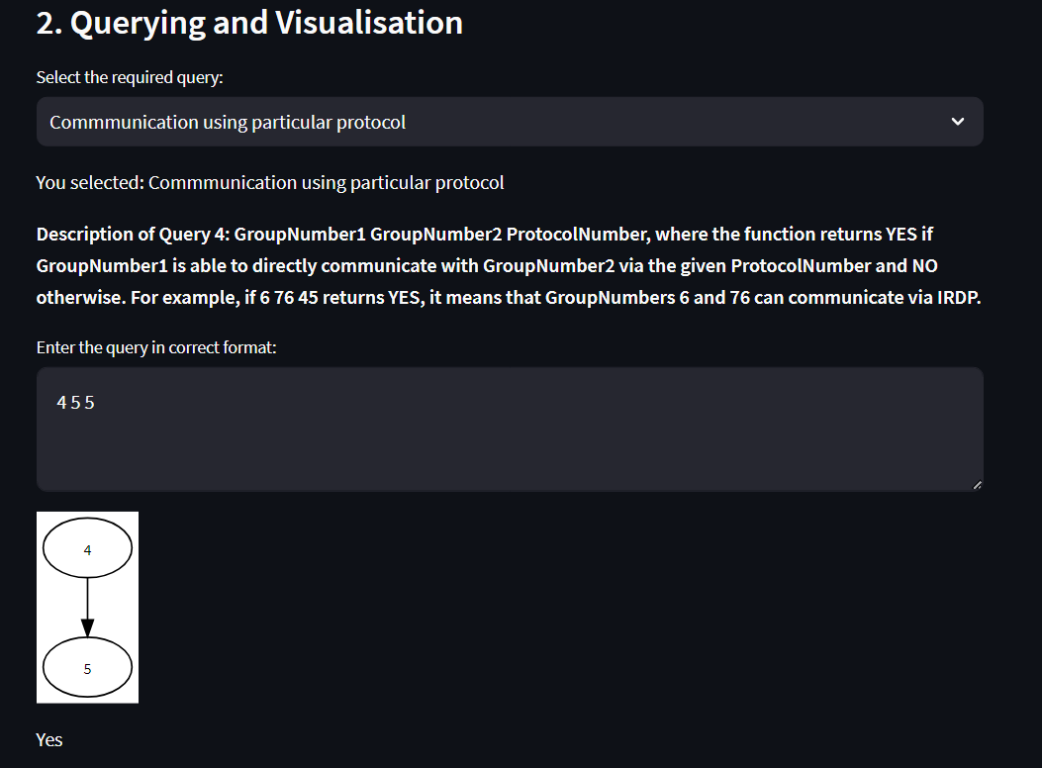
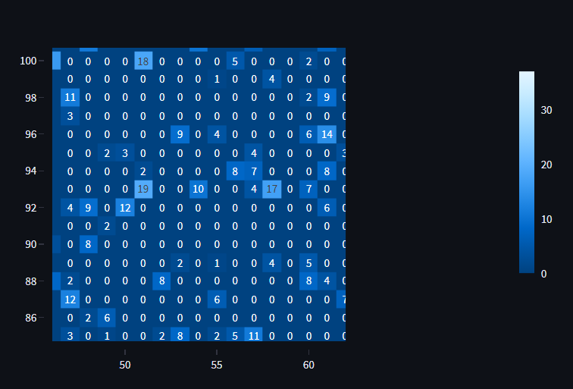
Query Processing and Explanation of Outputs using Visualizations and Charts
Customised Heatmap with Annotations which depict the number of edges from GroupNumber

